Slide 1

DATA STRUCTURE ALGORITHMS AND APPLICATIONS
Department of Computer Science
Prepared By:
Engr. Abdul Hafeez Babar
hafeezbabar@neduet.edu.pk
Thar Institute of Engineering, Science & Technology, Tharparkar
A Constituent college of NED university of engineering & Technology Karachi

Slide 2
Course Details:
Course Title:
Course Code:
Credit Hours:
Course Objectives:
Data Structures Algorithms & Applications
CT-157
3 + 1
The course is designed to teach students structures and schemes, which allow them to write programs to efficiently manipulate, store, and retrieve data.

Slide 3
Course Objective:
To extend and deepen the student's knowledge and understanding of algorithms and data structures.
To examine previously studied algorithms and data structures more rigorously and introduce the students to "new" algorithms and data structures.
It focuses the student's attention on the design of program structures that are correct, efficient in both time and space utilization, and defined in terms of appropriate abstractions.

Slide 4
Course Goals:
Upon completion of this course, a successful student will be able to:
  Describe the strengths and limitations of linear data structures, trees, graphs
  Select appropriate data structures for a speciﬁed problem
  Compare and contrast the basic data structures used in Computer Science: lists, stacks, queues, trees and graphs
  Describe classic sorting techniques
  Recognize when and how to use the following data structures: arrays, linked lists, stacks, queues and binary trees.
  Identify and implement the basic operations for manipulating each type of data structure

Slide 5
Course Goals(Continue…):
Upon completion of this course, a successful student will be able to:
  Perform sequential searching, binary searching and hashing algorithms.
  Apply various sorting algorithms including bubble,
  insertion, selection and quick sort.
  Understand recursion and be able to give examples of its use
  Use dynamic data structures

Slide 6
Course Learning Outcomes:
CLOs | Description | Taxonomy Level | PLO
1 | Comprehend various data structures and their algorithms and their use in simple applications | C2 | 1
2 | Analyze simple algorithms and determine their complexities | C4 | 3
3 | Apply the knowledge of data structures to other application domains | C3 | 2
Program Learning Outcomes (PLOs)
The course is designed so that students will achieve the following PLOs:
1 | Academic Education | 6 | Individual and Team Work
2 | Knowledge for Solving Computing Problems | 7 | Communication
3 | Problem Analysis | 8 | Computing Professionalism and Society
4 | Design / Development of solutions | 9 | Ethics
5 | Modern Tool Usage | 10 | Lifelong Learning
6

Slide 7
Course Outlines:
Abstract Data Types,
Complexity analysis,
Big O notation,
Stacks (Linked lists and array implementation)
Recursion and analyzing recursive algorithms
divide and conquer algorithms,
sorting algorithms (Selection, insertion, merge, quick, bubble, heap, radix),
Queue,
Deque,
priority queues
linked lists and its various types
searching and sorting in arrays

Slide 8
Course Outlines(Continue…):
hashing and indexing
trees and tree traversals
binary search trees
heaps
Graphs
breadth first and depth first traversal
shortest path
adjacency matrix
Infix to Prefix conversion
Evaluation of Postfix conversion
Hashing
Files

Slide 9
Recommended Course Books:
A Common-Sense Guide to Data Structures and Algorithms: Level Up Your Core Programming Skills”, Jay Wengrow, Pragmatic Bookshelf, 1st Edition, 2017.
“Data Structures with C”, Seymour Lipschutz, McGraw-Hill, 2011.
“Data Structures and Algorithms”, Alfred V. Aho, John E. Hopcroft and Jeffrey D. Ullman, Pearson Education Inc., Fourth Impression, 2010

Slide 10
Assignments / Sessional Marks, Midterm Exam, Final Exam
There will be
– one written exam at the end of the course
– one midterm exam around the middle of the course
– assignments / Sessional Tests / Projects
• To pass the course, one has to pass the written exam.
• Students who do not submit exercises and do not take part in the midterm (or fail the midterm) will be marked on the final exam alone.
• For students who submit all assignments, and take part in the midterm, the final mark will be a weighted average 60% exam mark + 20% midterm + 20% assignment mark/Sessional Marks

Slide 11
Assignments:
The assignments are a crucial part of the course.
The schedule for the publication and the handing in of the assignments will be announced in coming lectures.
A number of assignments include programming tasks. It is strongly recommended that you implement and run all programming exercises.
Assignments will be marked. The assignment mark will count towards the course marks.
Any attempt at plagiarism (copying from the web or copying from other students) leads to a 0 mark for all assignments.

Slide 12
Best of Luck
Best Luck
Best Luck
Let’s Start

Slide 13
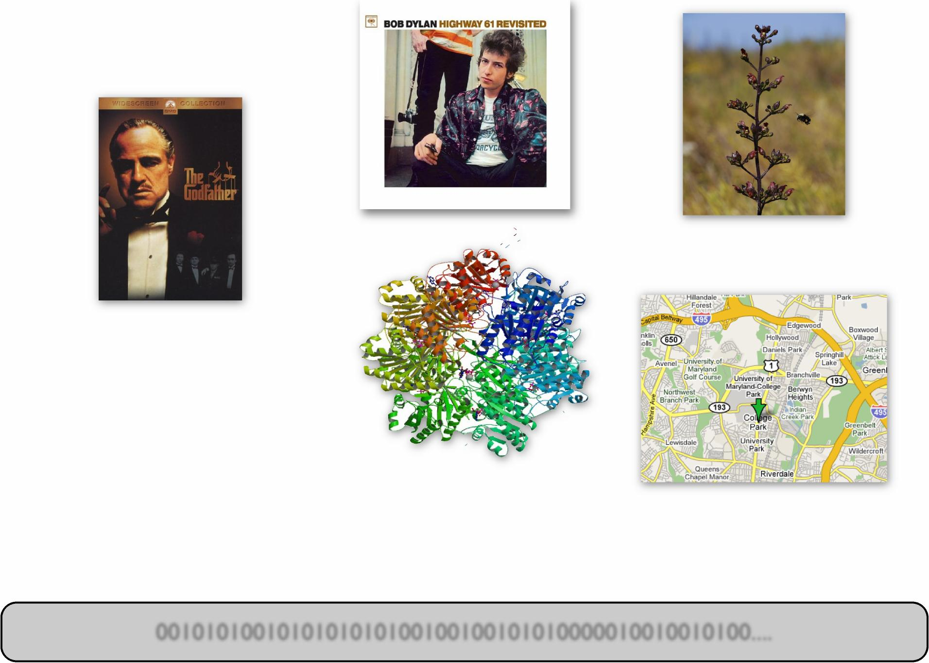
Digital Data
Music Photos
Movies
Protein
Shapes
DNA
Maps
gatcttttta tttaaacgat ctctttatta gatctcttat taggatcatg atcctctgtg gataagtgat tattcacatg gcagatcata taattaagga ggatcgtttg ttgtgagtga ccggtgatcg tattgcgtat aagctgggat ctaaatggca tgttatgcac agtcactcgg cagaatcaag gttgttatgt ggatatctac tggttttacc ctgcttttaa gcatagttat acacattcgt tcgcgcgatc tttgagctaa ttagagtaaa ttaatccaat ctttgaccca
0010101001010101010100100100101010000010010010100....
Notes:
‘’’’’’’’’’’’’’’’’’’’’’’’’’’’’’’’’’’’’’’’’’’’’’’’’’’’’’’’’’’’’’’’’’’’’’’’’’’’’’’’’’’’c’c’c’’’c’c’cccccccccccccccccccccccccccccccc’’c’c’c’cc’’’’’’’’’’’’’’’’’’’’’’’’’’’’’’’’’’’’’’’’’’’’’’’’’’’’’’’’’’’’’’’’’’’’’’’’’’’’’’’’’’’’’’’’’’’’’’’’’’’’’’’’’’’’’’’’’’’’’’’’’’’’’’’’’’’’’’’’’’’’’’’’’’’’’’’’’’’’’’’’’’’’’’’’’’’’’’’’’’’’’’’’’’’’’’’’’’’’’’’’’’’’’’’’’’’’’’’’’’’’’’’’’’’’’’’’’’’’’’’’’’’’’’’’’’’’’’’’’’’’’’’’’’’’’’’’’’’’’’’’’’’’’’’’’’’’’’’’’’’’’’’’’’’’’’’’’’’’’’’’’’’’’’’’’’’’’’’’’’’’’’’’’’’’’’’’’’’’’’’’’’’’’’’’’’’’’’’’’’’’’’’’’’’’’’’’’’’’’’’’’’’’’’’’’’’’’’’’’’’’’’’’’’’’’’’’’’’’’’’’’’’’’’’’’’’’’’’’’’’’’’’’’’’’’’’’’’’’’’’’’’’’’’’’’’’’’’’’’’’’’’’’’’’’’’’’’’’’’’’’’’’’’’’’’’’’’’’’’’’’’’’’’’’’’’’’’’’’’’’’’’’’’’’’’’’’’’’’’’’’’’’’’’’’’’’’’’’’’’’’’’’’’’’’’’’’’’’’’’’’’’’’’’’’’’’’’’’’’’’’’’’’’’’’’’’’’’’’’’’’’’’’’’’’’’’’’’’’’’’’’’’’’’’’’’’’’’’’’’’’’’’’’’’’’’’’’’’’’’’’’’’’’’’’’’’’’’’’’’’’’’’’’’’’’’’’’’’’’’’’’’’’’’’’’’’’’’’’’’’’’’’’’’’’’’’’’’’’’’’’’’’’’’’’’’’’’’’’’’’’’’’’’’’’’’’’’’’’’’’’’’’’’’’’’’’’’’’’’’’’’’’’’’’’’’’’’’’’’’’’’’’’’’’’’’’’’’’’’’’’’’’’’’’’’’’’’’’’’’’’’’’’’’’’’’’’’’’’’’’’’’’’’’’’’’’’’’’’’’’’’’’’’’’’’’’’’’’’’’’’’’’’’’’’’’’’’’’’’’’’’’’’’’’’’’’’’’’’’’’’’’’’’’’’’’’’’’’’’’’’’’’’’’’’’’’’’’’’’’’’’’’’’’’’’’’’’’’’’’’’’’’’’’’’’’’’’’’’’’’’’’’’’’’’’’’’’’’’’’’’’’’’’’’’’’’’’’’’’’’’’’’’’’’’’’’’’’’’’’’’’’’’’’’’’’’’’’’’’’’’’’’’’’’’’’’’’’’’’’’’’’’’’’’’’’’’’’’’’’’’’’’’’’’’’’’’’’’’’’’’’’’’’’’’’’’’’’’’’’’’’’’’’’’’’’’’’’’’’’’’’’’’’’’’’’’’’’’’’’’’’’’’’’’’’’’’’’’’’’’’’’’’’’’’’’’’’’’’’’’’’’’’’’’’’’’’’’’’’’’’’’’’’’’’’’’’’’’’’’’’’’’’’’’’’’’’’’’’’’’’’’’’’’’’’’’’’’’’’’’’’’’’’’’’’’’’’’’’’’’’’’’’’’’’’’’’’’’’’’’’’’’’’’’’’’’’’’’’’’’’’’’’’’’’’’’’’’’’’’’’’’’’’’’’’’’’’’’’’’’’’’’’’’’’’’’’’’’’’’’’’’’’’’’’’’’’’’’’’’’’’’’’’’’’’’’’’’’’’’’’’’’’’’’’’’’’’’’’’’’’’’’’’’’’’’’’’’’’’’’’’’’’’’’’’’’’’’’’’’’’’’’’’’’’’’’’’’’’’’’’’’’’’’’’’’’’’’’’’’’’’’’’’’’’’’’’’’’’’’’’’’’’’’’’’’’’’’’’’’’’’’’’’’’’’’’’’’’’’’’’’’’’’’’’’’’’’’’’’’’’’’’’’’’’’’’’’’’’’’’’’’’’’’’’’’’’’’’’’’’’’’’’’’’’’’’’’’’’’’’’’’’’’’’’’’’’’’’’’’’’’’’’’’’’’’’’’’’’’’’’’’’’’’’’’’’’’’’’’’’’’’’’’’’’’’’’’’

Slide 14
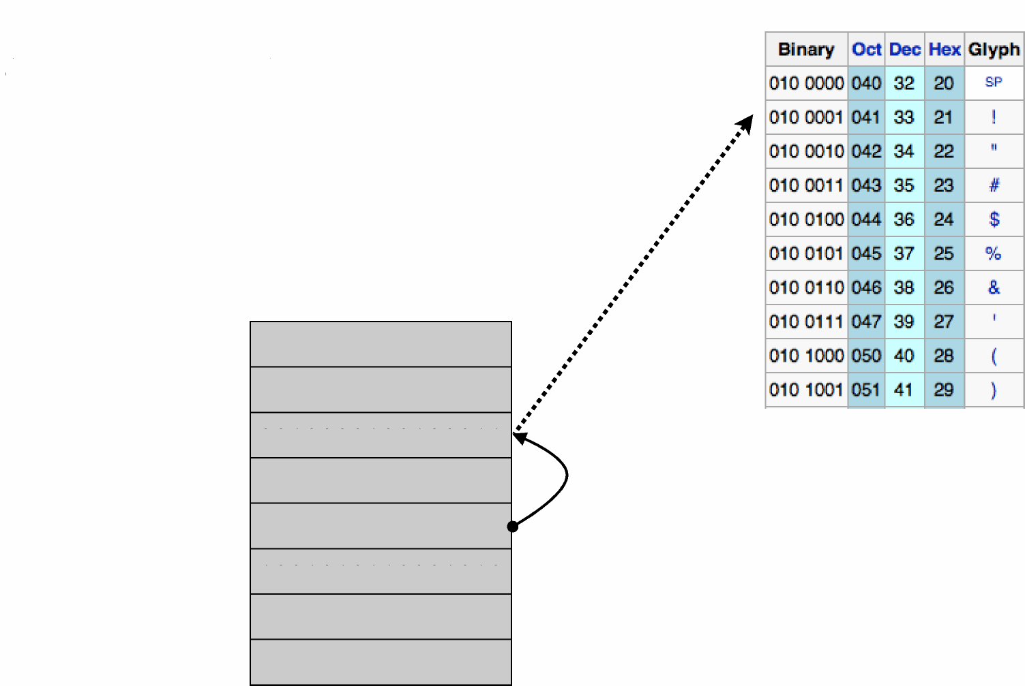
ASCII table:
agreement for
the meaning
of bits
RAM = Symbols + Pointers
(for our purposes)
16-bit words
0
2
4
6
8
10
12
14
0100101001111011
01101110 10 100000
00 10000 100 1000 11
10000 1000 10 1000 1
We may agree to
interpret bits as an
address (pointer)
0000000000000100
100 10 10 11000 10 10
1000000111000001
1111111111111111
Physically, RAM is a random accessible array of bits. | => We can store and manipulate arbitrary symbols (like letters) and associations between them.

Slide 15

Digital Data Must Be ...
Encoded (e.g. 01001001 <-> )
Arranged
- Stored in an orderly way in memory / disk
Accessed
- Insert new data
- Remove old data
- Find data matching some condition
Processed
Algorithms: shortest path, minimum cut, FFT, ...
The focus of
this class

Slide 16
Data Structures -> Data Structuring
How do we organize information so that we can find, update, add, and delete portions of it efficiently?

Slide 17
Data Structure Example Applications
How does Google quickly find web pages that contain a
search term?
What’s the fastest way to broadcast a message to a network
of computers?
How can a subsequence of DNA be quickly found within
the genome?
How does your operating system track which memory
(disk or RAM) is free?

Slide 18
What is a Data Structure Anyway?
It’s an agreement about:
how to store a collection of objects in memory,
what operations we can perform on that data,
the algorithms for those operations, and
how time and space efficient those algorithms are.

Slide 19
Why To learn Data Structure & Algorithms?
As applications are getting complex and data rich, there are three common problems that applications face now-a-days.
Data Search - Consider an inventory of 1 million(10 ) items of a store. If the
application is to search an item, it has to search an item in 1 million(10 ) items
every time slowing down the search. As data grows, search will become slower.
Processor speed - Processor speed although being very high, falls limited if the
data grows to billion records
Multiple requests - As thousands of users can search data simultaneously on a
web server, even the fast server fails while searching the data

Slide 20
What is it all about?
Solving problems
Get me from home to work
Balance my checkbook
Simulate a jet engine
Arrange Telephone Directory
Using a computer to help solve problems
Designing programs (architecture, algorithms)
Writing programs
Verifying programs
Documenting programs

Slide 21
Basic Terminologies
Data
  Data is unorganized raw facts that need processing without which it is seemingly random and useless to humans.
Information
  Information is a processed, organized data presented in a given context and is useful to humans.
Data item
  Data item refers to single unit of values. It holds one value at a time.
Collection
  Collection is array of data, they can hold multiple value.
Entity
  An entity is that which contains certain attributes or properties, which may be assigned values
Field
  Field is a single elementary unity of information representing an attribute of an entity.

Slide 22
Basic Terminologies (Continue…)
Record
  Record is a collection of field values of a given entity.
File
  File is a collection of records of the entities in a given entity set.
Database
  A database is a collection of information that is organized so that it can be easily accessed, managed and updated.
Data ware House
  Data warehouse is an information system that stores historical and commutative data from single or multiple sources.
Big Data
  Big Data is a collection of data that is huge in volume, yet growing exponentially with time.

Slide 23
Basic Terminologies (Continue…)
Keys (primary, foreign key, etc)
  Primary key: A primary key is used to ensure data in the specific column is unique
  Foreign Key: A foreign key is a column or group of columns in a relational database table that provides a link between data in two tables.
Data structure
  A data structure is a particular way of organizing data in a computer so that it can be used effectively.
Algorithm
  An algorithm is a set of instructions designed to perform a specific task.
Program
  Implementation of an algorithm in some programming language.

Slide 24
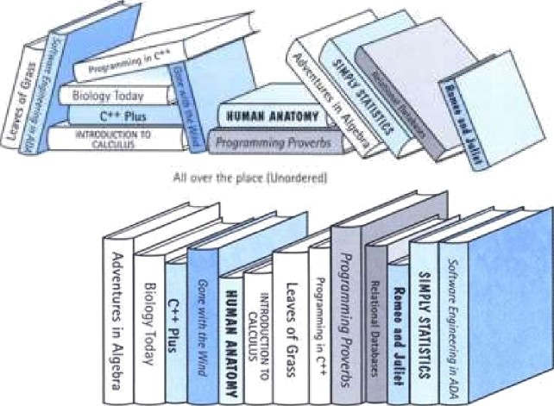
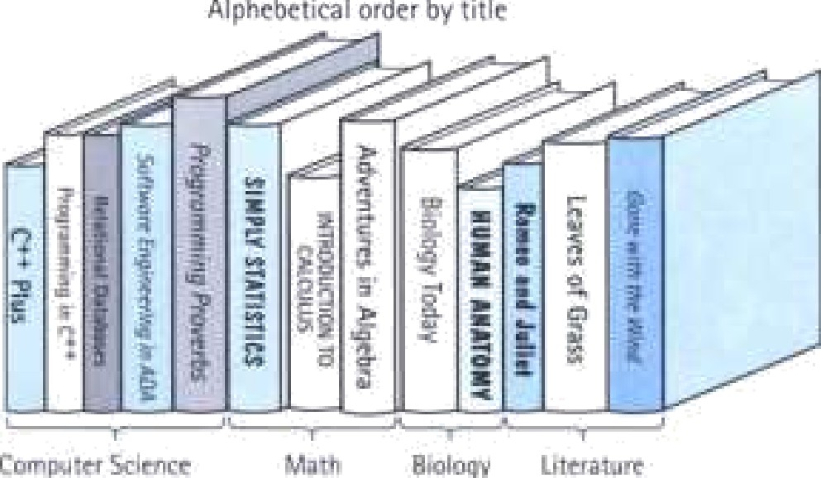
Data Structure
Example:library
  is composed of elements
(books)
  Accessing a particular book requires knowledge of the arrangement of the books
  Users access books only
through the librarian

Slide 25
Data Structure
is a systematic way to organize data in order to use it efficiently.
the logical or mathematical model of a particular organization of data
.
.
and so on
E.g.
Arrays
Linked List
Trees
Stack
Queue
Describe little bit

Slide 26

Classification of Data Structures
Data Structure
Primitive Data Structure | Non-Primitive Data Structure
Integer | Real | Character | Boolean
Linear Data Structure | Non-Linear Data Structure
Arrays
Linked List
Stacks
Queues
Trees
Graphs
Fig. 1. Classification of Data Structures

Slide 27
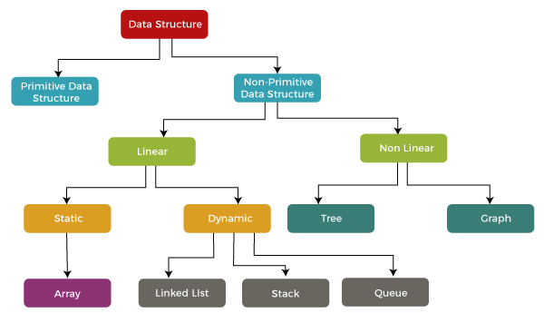
Classification of Data Structures
Fig.2. Classification of Data Structures

Slide 28
Why Data Structures are needed?
Processing Speed
Data Search
Multiple Request
Efficient memory use
Reusability
Abstraction

Slide 29
Data Structure : operations
Traversing
Searching
Inserting
Deleting
Sorting
Merging
Copying
Concatenation

Slide 30
Data Structure : operation
Example 1.6
An organization contain a membership file in which each record contains the following data for a given members:
Name, Address, Cell Number, Age, Gender
Suppose the organization wants to announce a meeting through a mailing. Then one would traverse the file to obtain Name and Address for each number.
Suppose one wants to find the names of all members living in a certain area. Again one would traverse the file to obtain the data.
Suppose one wants to obtain address for a given number, then one would search file for the record containing number.
Suppose a new position joins the organization. Then one would insert his or her record into the file.
Suppose a members dies. Then one would delete his or her record from the file.
Suppose a member has moved and has a new address and cell number. Given the name of the member, one would first need to search for the record in the file. Then one would perform the update. i.e change the items in the record with the new data.
Suppose one wants to find the number of members 65 or older. Again one would traverse the file, counting such numbers.

Slide 31
Algorithm
Algorithm is a step by step procedure, which defines a set of instruction to be executed in a certain order to get the desired output.
Algorithm are generally created independent of underlying languages, i.e algorithm can be implemented in more than one programming language.
Characteristics of an Algorithm:
Unambiguous
Input
Output
Finiteness
Feasibility
Independent
Sub algorithm: A sub algorithm is just an algorithm that is used as a part of another algorithm.
Notes:
Every day we come across many problems and we find one or more than one solutions to that particular problem. Some solutions may be efficient as compared to others and some solutions may be less efficient. Generally, we tend to use the most efficient solution.
For example, while going from your home to your office or school or college, there can be "n" number of paths. But you choose only one path to go to your destination i.e. the shortest path.

Slide 32
How to write an Algorithm?
There are no well-defined standard for writing an algorithm. Rather , its problem and resource dependent. Algorithm are never written to support a particular programming code.
As we know that all programming languages share basic code constructs like loops (do, for, while ), flow control(if-else), etc. these common constructs can be used to write an algorithm.
We write algorithm in step-by-step manner. But it is not always the case.
Algorithm writing is a process and is executed after the problem domain is well defined. That is , we should know the problem domain, for which we designing a solution.

Slide 33
Efficiency of an algorithm
Efficiency of an algorithm denotes the rate at which an algorithm solves a problem of size n.
It is measured by the amount of resources it uses, the time and the space.
The time refers to the number of steps the algorithm executes while the space refers to the number of unit memory storage it requires.
An algorithm’s complexity is measured by calculating the time taken and space required for performing the algorithm.
The input size, denoted by n, is one parameter , used to characterize the instance of the problem.
The input size n is the number of registers needed to hold the input (data segment size).

Slide 34
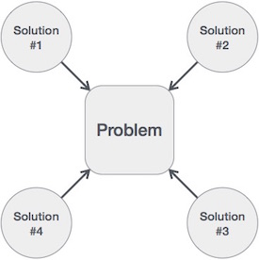
How to write an Algorithm?
Example:
Another Alternative:
Step 1: Start
Step 2: Declare the three integers a, b, c
Step 3: define values of a and b
Step 4: add values of a and b
Step 5: store output of step 4 to c
Step 6: print c
Step 7: STOP / Exit
Step 1: Start Addition
Step 2: get values of a and b
Step 3: add a and b and put into c c <- a + b
Step 4: display c
Step 5: stop / exit
We design an algorithm to get a solution of a given problem. A problem can be solved in more than one ways.

Slide 35
Algorithm
Problems involving numbers, strings, mathematical objects:
for two numbers, determine their sum, product, …
for two numbers, compute their greatest common divisor
for a sequence of strings, find an alphabetically sorted permutation of the sequence
for two arithmetic expressions, find out if they are equivalent
for a program in Java, create an equivalent program in byte code
on a map, find for a given house the closest bus stop We call instructions, recipes, for such problems algorithms

Slide 36
Pseudo Code
Pseudocode is an informal way of programming description that does not require any strict programming language syntax or underlying technology considerations.
It is used for creating an outline or a rough draft of a program. Pseudocode summarizes a program’s flow, but excludes underlying details.
System designers write pseudocode to ensure that programmers understand a software project's requirements and align code accordingly.
Pseudocode is not an actual programming language. So it cannot be compiled into an executable program.
Pseudocode is understood by the programmers of all types.
It enables the programmer to concentrate only on the algorithm part of the code development.

Slide 37
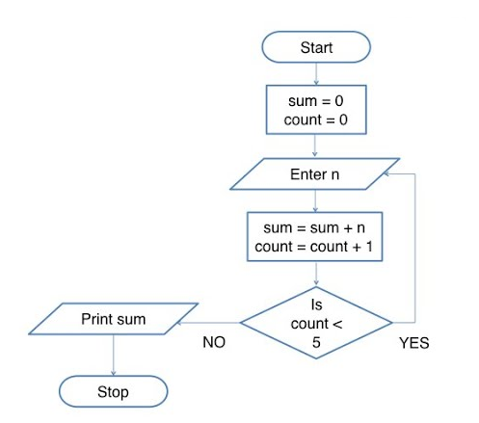
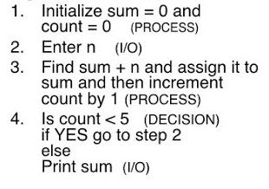
Pseudo Code
Flowchart
Example:
Find the sum of 5 numbers

Slide 38
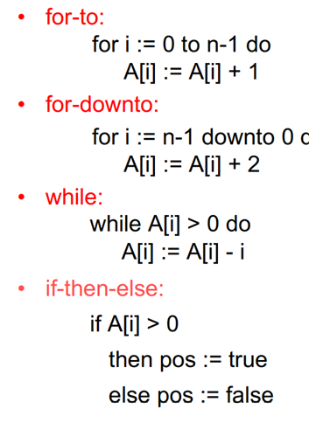
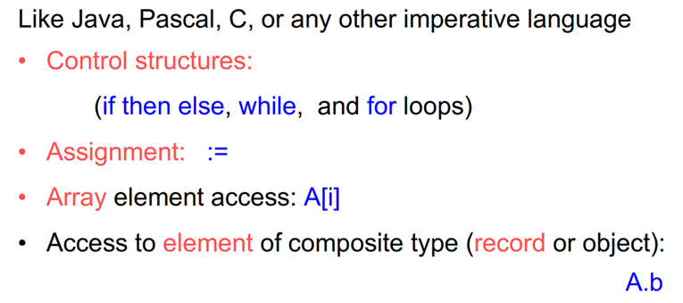
Control Structures in Pseudo Code

Slide 39
Abstract Data Type (ADT)
Abstract Data Type(ADT) is a data type, where only behavior is defined but not implementation.
Refers to Abstraction.
Examples :
  ARRAY
  LIST
  MAP
  QUEUE
  STACK
  TABLE
  TREE
  VECTOR
Real Time Examples:
Notes:
book is Abstract (Telephone Book is an implementation)

Slide 40
Abstract Data Type
Example: List Representations
1
2
3
Consider a List L consisting of data items → 1,2,3,4,..9 as shown in Fig.
4
5
6
1
2
3
4
9
7
8
9
(a) Linked List
(b) Matrix
1
1
6
6
2
5
2
5
3
4
7
8
9
3
4
7
8
9
(c) Tree
(d) Graph

Slide 41
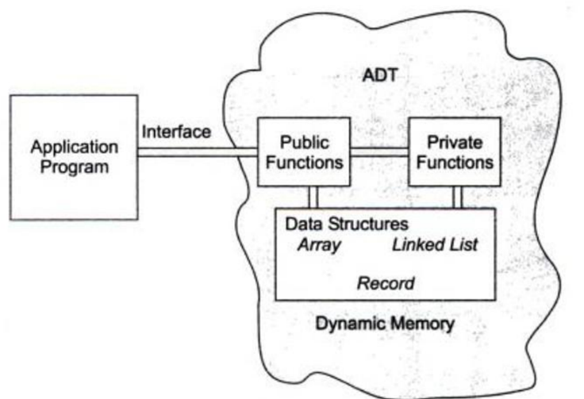
Abstract Data Type Model
Fig: ADT Model
Notes:
An abstract data type thus can be further defined as a data declaration packaged together with the operations that are meaningful for the data type, in other words, we encapsulate the data and the operations on the data, and then we hide them from the user. Like Data abstraction
The user need not know the data structure to use the ADT. Considering example 8.1, the application program should have no knowledge of the data structure. All references to and manipulation of the data in the queue must be handles through defined interfaces in the structure. Allowing the application program to directly references the data structures is a common fault in many implementation. This prevents the ADT from being fully portable to other applications.
As representation of the ADT model is shown in Fig. 1.13. Notice that there are two different parts of the ADT model – functions(public and private) and data structures. Both are contained within the ADT model itself, and do not come within the scope of the application program. On the other hand, data structures are available to all of the ADTs functions as required, and a function may call on any other function to accomplish its task. This means that data structures and functions are within the scope of each other.
data are entered, accessed, modified and deleted through the external application programming interface. This interface can only access the public functions. For each ADT operation, there is an algorithm that perform its specific task. The operation name and parameters are available to the application, and they provide the only interface to the application.
When a list is controlled entirely by the program , it is implemented using simple structures.
Note that it is not enough if we just encapsulate the structures in an ADT, it is also necessary for multiple version of the structure to coexist. Therefore, we must hide the implementation form the user, while being able to store different data at the same time.
Two basic structures, namely array and linked list, can be used to implement an ADT ist.

Slide 42


